Slide 1
Twitter Sentiment Analysis

Slide 2
Presented by:
Maurus Maria Rubenson A
Hashim H B
Kishore V S

Slide 3

Abstract
In recent days with the explosion of Big Data there is a large demand for organisations and data scientists to perform information extraction using non-traditional sources of data.
Twitter is one of the non-traditional data sources with unlimited potential. It contains a large reserve of data sets
One of the available tools is twitter API which lets us collect data and various other information about the tweets
With use of this API we can collect data related to an specific domain
and create an CNN model for it

Slide 4
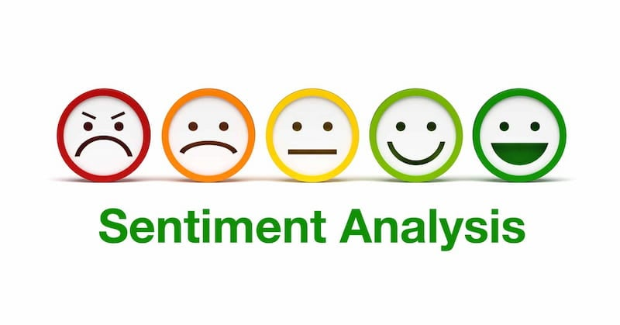
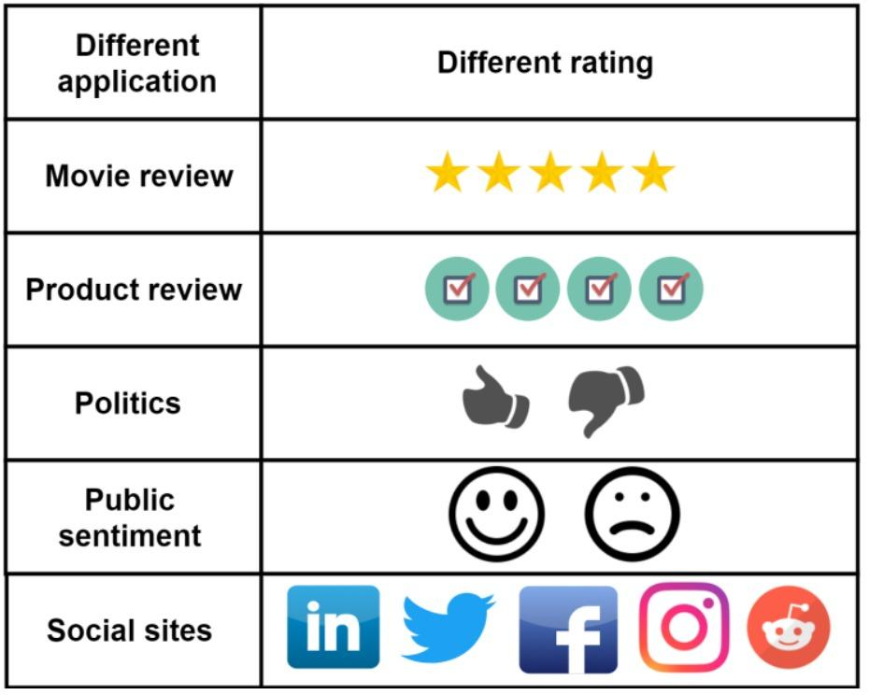
Sentiment analysis, also referred to as opinion mining, is an approach to natural language processing (NLP) that identifies the emotional tone behind a body of text. This is a popular way for organizations to determine and categorize opinions about a product, service, or idea.

Slide 5
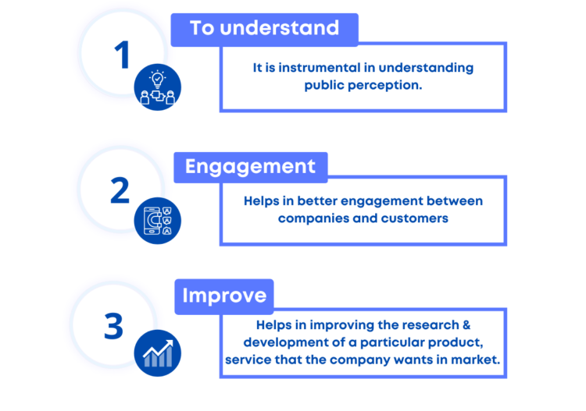
Importance of Sentiment Analysis

Slide 6
Introduction
Twitter is a service for social networking including friends, family, coworkers to communicate and keep others updated their status
These huge loads of tweets can be used wisely to train our Natural Language Processing models.
The values obtained from the prediction can be used for various fields such as the opinion of a brand or view of implementing new models or policies
Aim of twitter sentiment analysis is that it allows you to keep track of what’s being said about your product or service on social media, and can help you detect angry customers or negative mentions before they escalate

Slide 7



Applications that uses twitter sentiment analysis are :
1.Social Media Monitoring
2.Customer Service
3.Market Research
4.Brand Monitoring

Slide 8
Literature Survey
[1] CNN for situations understanding based on sentiment analysis of twitter data by Shiyang Liaoa, Junbo Wangb, Ruiyun Yua, Koichi Satob, Zixue Cheng at 8th International Conference on Advances in Information Technology, IAIT 2016, 19-22 (December 2016)
[2] A sentiment analysis study for twitter using the various model of convolutional neural network by Sartini, Subiyanto and M F Alim at Journal of Physics: Conference Series, ICMSE 2020 (2021)
[3] Twitter sentiment analysis using distributed word and sentence representation by Dwarampudi Mahidhar Reddy, Dr. N V Subba Reddy and Dr. Prema K V at arXiv :1904.12580v1 [cs.IR] (1 April 2019)
[4] Using Word2Vec to Process Big Text Data by Long Ma and Yanqing Zhang conference held at Big Data (Big Data), 2015 IEEE International Conference At: San Jose, CA
(October 2015)
[5] Sentiment Analysis of Twitter Data: A Survey of Techniques by Vishal A.Kharde and S.S.Sonawane held at International Journal of Computer Applications 139(11): 5-15
(April 2016)
[6] Deep Learning applied to NLP by Marc Moreno Lopez and Jugal Kalita at arXiv:1703.03091 [cs.CL] (9 March 2017)

Slide 9
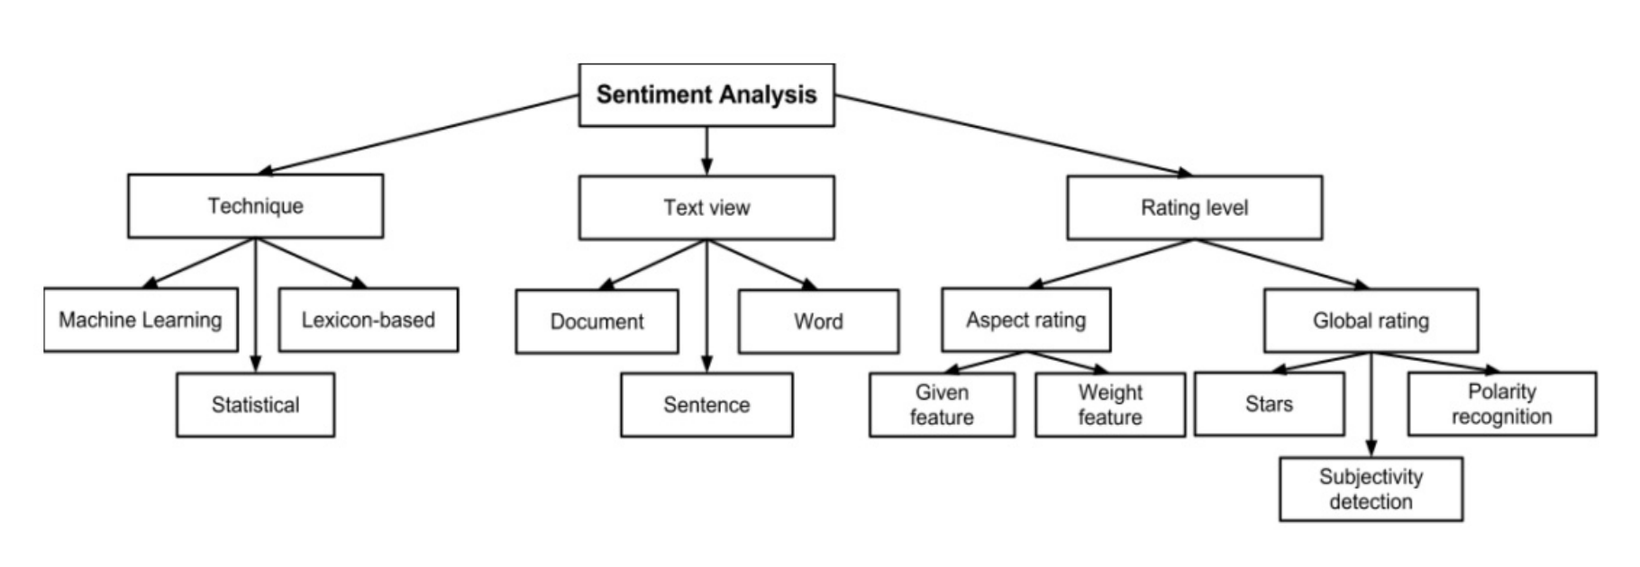
Existing System
They are 4 main models used in sentiment analysis :
Rule based or Lexicon based approach
Automated approach or Machine Learning approach
Deep Learning Models
Hybrid Approach

Slide 10
Best Open Source APIs for Natural Language Processing
NLTK : Programmers that want a relatively easy start with NLP code.
SpaCy : Developers that want high-performance NLP analysis.
TextBlob : Developers that want a user-friendly interface and functionality.
Stanford Core NLP : Researchers and developers who want to perform multi-level and multi-language NLP.
GenSim : Developers that primarily want to perform document comparison NLP tasks.

Slide 11
Present Algorithms
Naive Bayes: This algorithm is known to work well for many text classification problems and requires relatively few training examples.
Support Vector Machine: Like Naive Bayes classifiers, support vector classifiers also work well for text classification and require relative few training examples.
Decision Tree: Decision Trees often do a good job of learning to classify and have the additional property of producing easily explainable results in the form of decision trees.
XGBoost: This algorithm uses a set of different decision trees known as a random forest. It is known to be both fast and often achieves very high accuracy. However, it is not as interpretable as a simple decision tree.
k-Nearest Neighbors: This algorithm works by finding the training examples closest to the test example.

Slide 12

Why CNN in Sentimental Analysis?
Convolutional Neural Network is one of the most effective methods to do text classification.
CNN has a convolutional layer to extract information by a larger piece of text, so we work for sentiment analysis with convolutional neural network, and we design a simple convolutional neural network model and test it on benchmark.
The result shows that it achieves better accuracy performance in twitter sentiment classification than some of traditional method such as the SVM and Naive Bayes methods.

Slide 13
Proposed model
System Modules
Tweepy
2. Word2Vec Model
Word Embeddings
Continuous Bag of Words
Skip-Gram
Word2Vec Vectors
3. Convolutional Neural Network

Slide 14
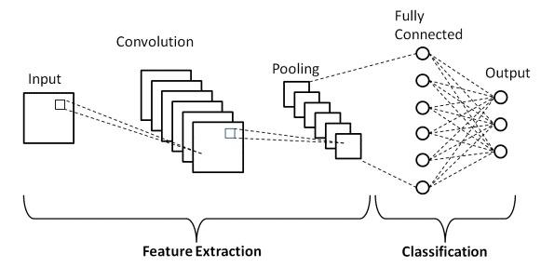
Proposed model
We will be collecting 1.6 M data from the twitter API. These datasets are divided into training datasets and testing datasets
Before we Use the Textblob we will convert the emojis in the text and convert them into the appropriate meanings
The Preprocessing of data does not end here as they are various steps involved in making the data adaptable to our model that is being created

Slide 15
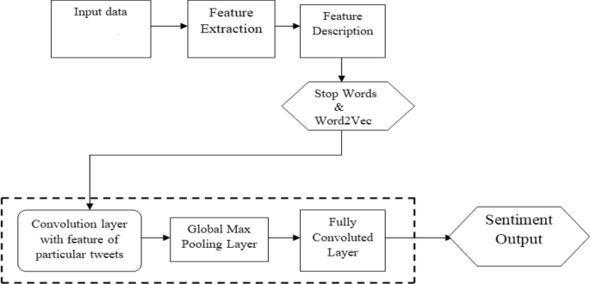
Process Overview

Slide 16
The steps involved in text analytics
1
2
3
4
Collect tweets
Pre-process tweets
Apply sentiment analysis
Apply named entity recognition
5
Cluster Tweets

Slide 17
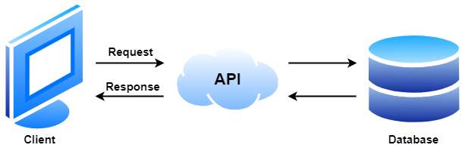
Twitter API
The tweets are collected through Tweepy
The process of analyzing the tweets and the texts and emojis in them to classify the opinions of the people and their reaction towards the tweet, along with the viewpoint the owner of the tweet into positive, negative or neutral
Twitter does not only contains text but also image,video and other ways of expressing one self which can be incorporated in future.

Slide 18
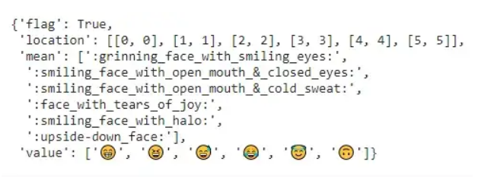
Data Preprocessing
The First step is converting the emojis to their respective texts using the demote package during the data mining process through Twitter API.

Slide 19
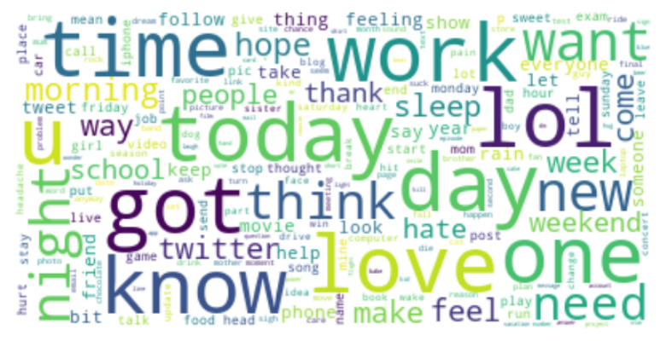
Data Preprocessing
The next step is to remove the stop words from the texts so that the quality of the final word vectors will be high and non relevant and outliers are removed from the Tweets before creating our embedding layer using the gensim word2vec model.
After removing the stop words we are left with all the important and relevant words which helps to classify the polarity of texts

Slide 20
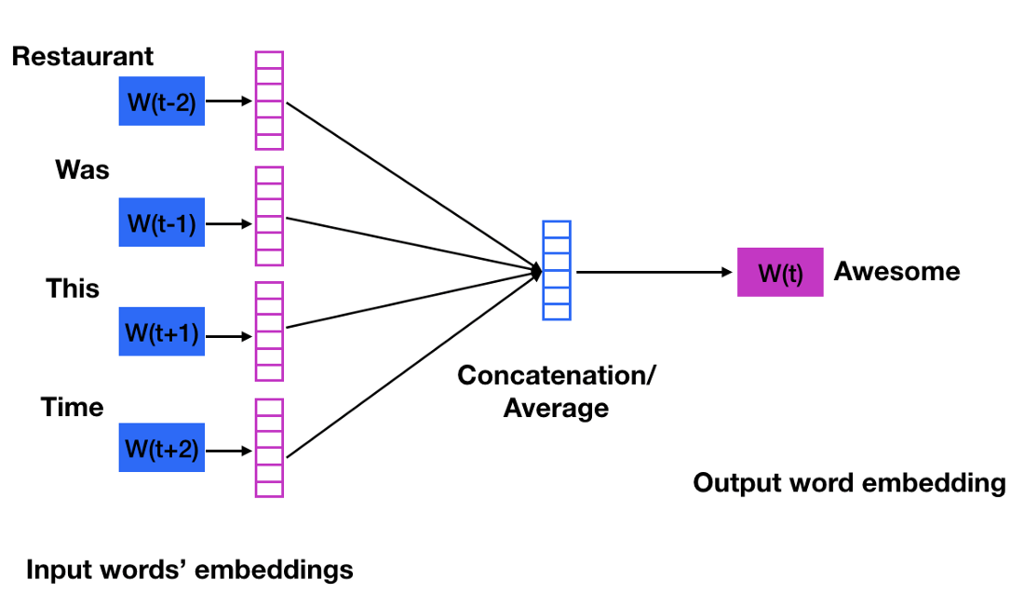
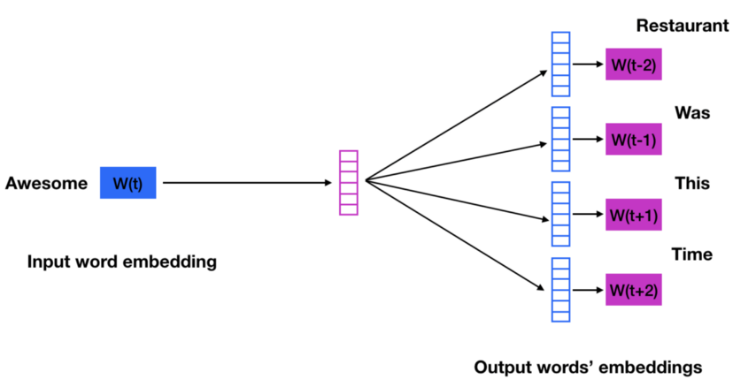
Conversion of word to vector
Converting words to vectors, or word vectorization, is a natural language processing (NLP) process. The process uses language models to map words into vector space. A vector space represents each word by a vector of real numbers. It also allows words with similar meanings have similar representations.

Slide 21
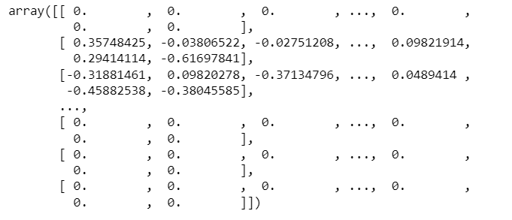
Conversion of word to vector
Then the word2vec is used to create vectors and words with most similar meanings. This helps to find the root words and help us make it classify the polarity using the embedding matrix created for all these individual data.

Slide 22
Convolutional Neural Network
Model: "sequential"
_________________________________________________________________
Layer (type) Output Shape Param #
=================================================================
embedding (Embedding) (None, 300, 300) 12659700
dropout (Dropout) (None, 300, 300) 0
lstm (LSTM) (None, 100) 160400
dense (Dense) (None, 1) 101
=================================================================
Total params: 12,820,201
Trainable params: 160,501
Non-trainable params: 12,659,700
_________________________________________________________________

Slide 23
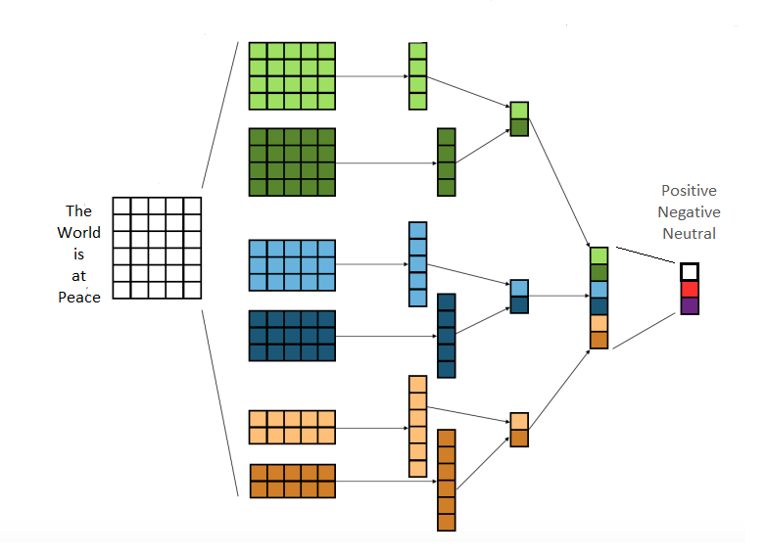
Convolutional Neural Network

Slide 24
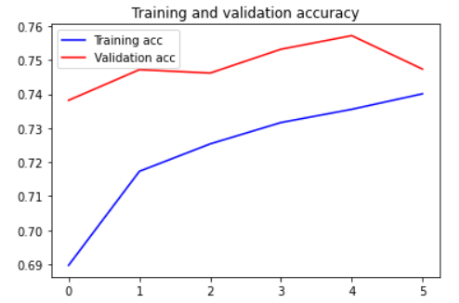
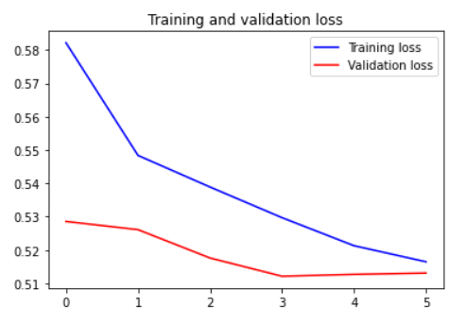
Result and Discussion
This embedding Layer is fit into the Convolutional Neural Network Sequential Model and the model is trained. The time for each model takes up a huge amount of time as each text is converted to a vector of 300 words of array. This each time the model is trained and overlapped with a loss of 50%. The final output of the accuray and the confusion matrix is given below.

Slide 25
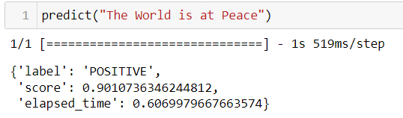
Result and Discussion
As the accuracy of our trained model is given above and we can see the clear increase of the accuracy through epoch is clearly seen
This model can be further improved as we only trained it for 6 hours and by utilizing all the data we can get accuracy up to more than 98%
The present model's confusion matrix is present below and we can see the true positive compared with other three factors in it.

Slide 26
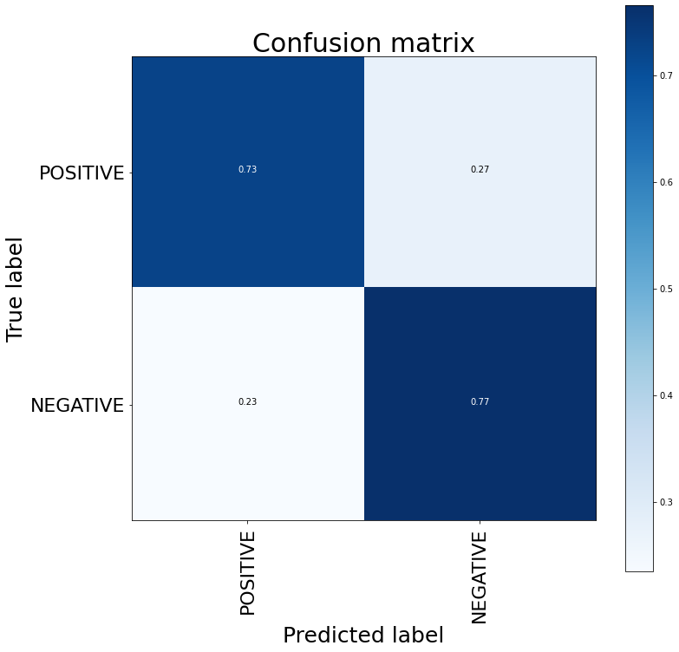
Result and Discussion

Slide 27
Conclusion and Future Work
We have applied a specific way to collect data from the twitter database so that it helps us overcome the domain specific limitations and implement one of the major concepts which is applying world knowledge to the Natural Language Processing techniques.
We will also include the emojis and convert them to the related meaningful texts
As twitter is a social networking platform it will provide us with quality data and to help us build models to directly connect with the people or the audience.
With use of twitter as a Database we can explore various clusters of data and we can do proper collection of data and remove the other domain texts at the collection process itself.
The speed of collection may help us build models of each domain separately and using hierarchical methods we can classify the polarities of tweets of specific domains

Slide 28
Reference
https://liris.cnrs.fr/Documents/Liris-6508.pdf
https://towardsdatascience.com/getting-started-with-data-collection-using twitter-api-v2-in-less-than-an-hour-600fbd5b5558
https://liris.cnrs.fr/Documents/Liris-6508.pdf
https://towardsdatascience.com/getting-started-with-data-collection-using-twitter-api-v2-in-less-than-an-hour-600fbd5b5558
https://www.analyticsvidhya.com/blog/2021/06/twitter-sentiment-analysis-a-nlp-use-case-for-beginners/
https://www.kaggle.com/code/nitin194/twitter-sentiment-analysis-word2vec-doc2vec
https://towardsdatascience.com/predicting-tweet-sentiment-with-word2vec-embeddings-67aace9b019d

